Slide 1
Pythagoras’ theorem in context
Geometrical properties: similarity and Pythagoras’ theorem

Slide 2
How our teaching resources are designed for the classroom

Slide 3
I can use and apply Pythagoras’ theorem to solve problems in a range of contexts.

Slide 4
The perpendicular height is the perpendicular distance from the base to the opposite vertex.
Pythagoras’ theorem shows that the sum of the squares of the two shorter sides of a right-angled triangle is equal to the square of its longest side (the hypotenuse).
A hypotenuse is the side of the right-angle triangle which is opposite the right-angle.

Slide 5

Pythagoras’ theorem in context
Contexts modelled by right-angled triangles
Analysing and evaluating modelled contexts

Slide 6
Contexts modelled by right-angled triangles
There are many contexts in the real world that involve:
lengths or distances that are perpendicular to each other
a third length that bounds an imaginary right-angled triangle
And sometimes it is helpful to model these contexts as right-angled triangles in order to help calculate important lengths or distances.

Slide 7


Contexts modelled by right-angled triangles
For example, in order for this strand of spaghetti to cook evenly, it has to be submerged completely in the saucepan, with no part of it sticking out.
What information about the spaghetti and the saucepan might we need in order to see if the spaghetti will fit fully?
strand of spaghetti
saucepan

Slide 8
Contexts modelled by right-angled triangles
the height of the saucepan,
If we know
and its maximum length (the diameter of its circular base),
we can calculate the maximum distance from one end of the saucepan to the diagonally opposite other end of it.
And if the strand of spaghetti is shorter than this distance, then it will fit in the pan.
28 cm
12 cm
strand of spaghetti
22 cm

Slide 9
Contexts modelled by right-angled triangles
We can model the saucepan as a right-angled triangle, with the height and maximum base of the saucepan represented by the two shorter sides of this triangle.
The maximum distance of the saucepan is the hypotenuse of this right-angled triangle.
12² + 22² = x²
628 = x²
x² = 628
hypotenuse (x cm)
12 cm
x² = 25.1
12 cm
height
The maximum distance from one end of the saucepan to the other is 25.1 cm.
22 cm
maximum base

Slide 10
Contexts modelled by right-angled triangles
And because the length of the spaghetti strand is 28 cm, it is longer than the hypotenuse of this right-angled triangle (25.1 cm).
This means it will not fully fit in the pan - there will be a small part of the spaghetti that won’t be submerged in water, and therefore won’t cook evenly.
2.9 cm not submerged into saucepan
hypotenuse (25.1 cm)
28 cm
12 cm
height
strand of spaghetti
22 cm
maximum base

Slide 11



Contexts modelled by right-angled triangles
Jun only wants to use long pencils that stick out of the pencil pot, so that he doesn’t have to rummage around to find short pencils.
Whilst this pencil is taller than the pencil pot, he’s worried that the pencil will tip over into the pencil pot and be stuck inside.
Jun models the pencil pot as a right-angled triangle. What will the lengths of the two shorter sides of this triangle be?
11 cm
a
14 cm
11 cm
6 cm
b
6 cm

Slide 12
Contexts modelled by right-angled triangles
Jun only wants to use long pencils that stick out of the pencil pot, so that he doesn’t have to rummage around to find short pencils.
Whilst this pencil is taller than the pencil pot, he’s worried that the pencil will tip over into the pencil pot and be stuck inside.
What is the length of the hypotenuse of this triangle, rounded to 2 decimal places?
12.53 cm
11 cm
14 cm
11 cm
6 cm
6 cm

Slide 13
Contexts modelled by right-angled triangles
Jun only wants to use long pencils that stick out of the pencil pot, so that he doesn’t have to rummage around to find short pencils.
The hypotenuse of this triangle is 12.53 cm.
What conclusion can we draw about the pencil and the pencil pot?
a
b
The pencil is long enough to stick out of the pencil pot.
The pencil is not long enough to stick out of the pencil pot, and will get stuck inside.
14 cm

Slide 14
Contexts modelled by right-angled triangles
Jun only wants to use long pencils that stick out of the pencil pot, so that he doesn’t have to rummage around to find short pencils.
The hypotenuse of this triangle is 12.53 cm.
What conclusion can we draw about the pencil and the pencil pot?
The pencil is long enough to stick out of the pencil pot, as the pencil is longer (14 cm) than the hypotenuse of the right-angled triangle (12.53 cm), meaning it is longer than the greatest distance inside the pencil pot.
a
The pencil is long enough to stick out of the pencil pot.
14 cm

Slide 15
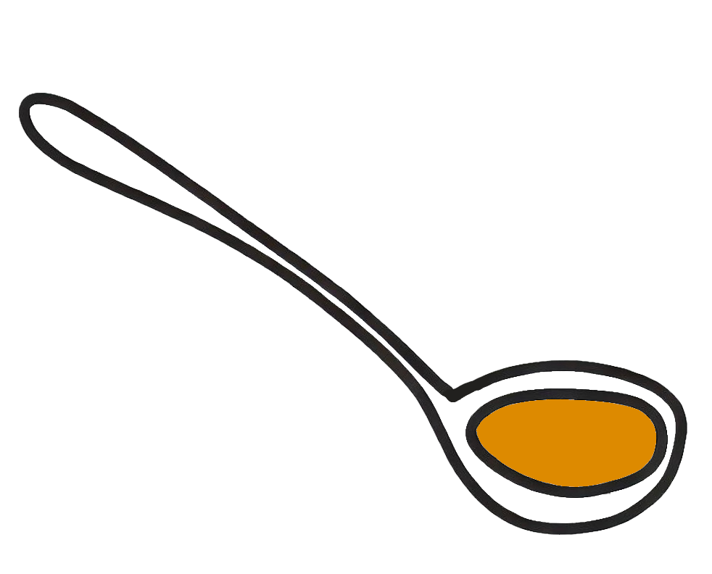
Contexts modelled by right-angled triangles
1) For this ladle to be usable with the saucepan, it has to be long enough that it won’t sink completely into the saucepan.
The saucepan is 20 cm tall and has a maximum base width of 30 cm.
a) The right-angled triangle models the saucepan. Label the saucepan and the right-angled triangle with the appropriate lengths.
b) Using Pythagoras’ theorem, explain whether the ladle is long enough to be used with this saucepan.
saucepan
ladle
35 cm

Slide 16
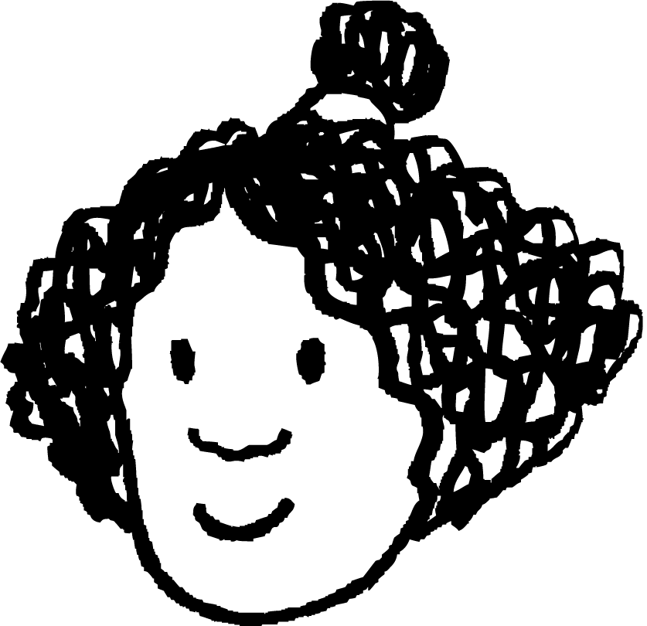
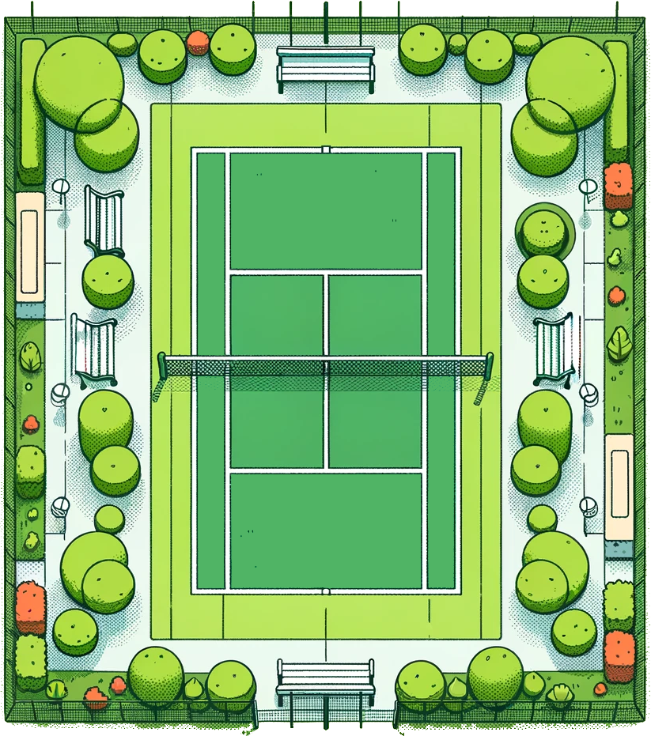
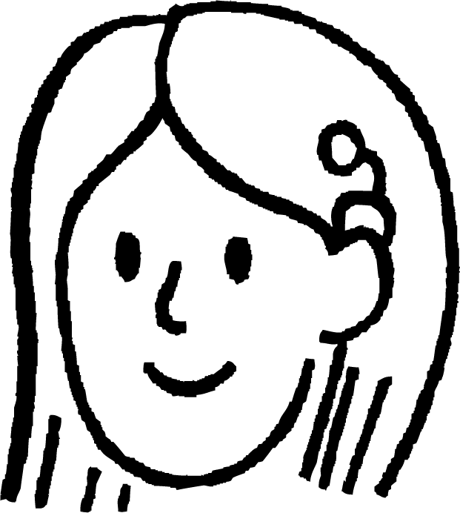
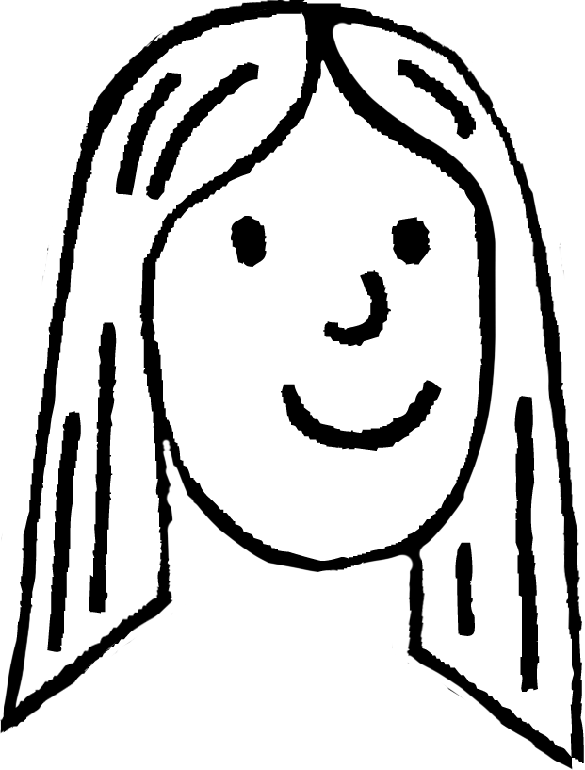
Contexts modelled by right-angled triangles
Izzy
2) Izzy is practicing her backhand shots. She can hit a backhand shot 28 metres.
Sofia and Laura stand at different corners of the court.
a) Model this context onto this right-angled triangle, labelling any relevant distances given in the context.
24 m
b) Explain whether Izzy’s backhand shot can reach Sofia.
11 m
c) Using Pythagoras’ theorem, explain whether Izzy’s backhand shot can reach Laura.
Sofia
Laura

Slide 17

Contexts modelled by right-angled triangles
3) A train conductor uses a 256 cm long access ramp to help passengers board a maglev train.
The step to board the train is 43 cm higher than the platform the passengers are waiting on.
How far onto the platform will the access ramp reach (to 1 d.p.)?
train
access ramp
platform
train

Slide 18
Contexts modelled by right-angled triangles
1 a) The right-angled triangle models the saucepan. Label the saucepan and the right-angled triangle with the appropriate lengths.
b) Using Pythagoras’ theorem, explain whether the ladle is long enough to be used with this saucepan.
The ladle is too short, at 35 cm.
This is because the maximum distance inside the saucepan is the diagonal length of 36 cm, and so the ladle can sink completely into the saucepan.
saucepan
ladle
36 cm
20 cm
20 cm
35 cm
30 cm
30 cm

Slide 19
Contexts modelled by right-angled triangles
Izzy
I
2 a) Model this context onto this right-angled triangle, labelling any relevant distances given in the context.
26.4 m
24 m
24 m
S
L
b) Explain whether Izzy’s backhand shot can reach Sofia.
11 m
It can, as Izzy’s shot of 28 m is longer than the 24 m between her and Sofia.
11 m
c) Using Pythagoras’ theorem, explain whether Izzy’s backhand shot can reach Laura.
Sofia
Laura
Using Pythagoras’ theorem, the distance between Izzy and Laura is 26.4 m. Therefore, Izzy’s 28 m shot can reach Laura.

Slide 20
Contexts modelled by right-angled triangles
3) A train conductor uses a 256 cm long access ramp to help passengers board a maglev train.
The step to board the train is 43 cm higher than the platform the passengers are waiting on.
train
256 cm
43 cm
access ramp
252.4 cm
platform
The minimum horizontal distance away from the train is 252.4 cm.
train
252.4 cm

Slide 21
Pythagoras’ theorem in context
Contexts modelled by right-angled triangles
Analysing and evaluating modelled contexts

Slide 22
Analysing and evaluating modelled contexts
Sometimes, we have to deal with descriptions of contexts without any diagrams, and model them as right-angled triangles.
For example:
A small bird sits 3 metres horizontally away from a tall tree.
The bird flies 9 metres to the top of the tree.
How tall is the tree, rounded to 1 decimal place?
How can this problem be modelled as a right-angled triangle, and solved using Pythagoras’ theorem?

Slide 23
Analysing and evaluating modelled contexts
A small bird sits 3 metres horizontally away from a tall tree.
The bird flies 9 metres to the top of the tree.
How tall is the tree, rounded to 1 decimal place?
flight path of bird
The bird, the tree, and the distances between them are now modelled by a right-angled triangle, where we want to find the height of the tree: the length of one of the shorter sides of the triangle.
9 m
tree
x metres tall
bird
3 m

Slide 24
Analysing and evaluating modelled contexts
A small bird sits 3 metres horizontally away from a tall tree.
The bird flies 9 metres to the top of the tree.
How tall is the tree, rounded to 1 decimal place?
x² + 3² = 9²
flight path of bird
x² + 3² = 9² – 3²
9 m
x² + 3² = 72
tree
x² + 3² = 72 = 8.5 (1 d.p.)
x metres tall
The tree is 8.5 metres tall.
bird
3 m

Slide 25
Analysing and evaluating modelled contexts
A 10 metre tall flagpole is supported by a long metal wire that is tied to the top of the flagpole and a hook in the ground, 4 metres away from the base of the flagpole.
The flagpole and hook can be modelled by this right-angled triangle.
On the triangle, what does this vertical height represent?
a
the flagpole
What is the length of this side of the triangle?
10 metres

Slide 26
Analysing and evaluating modelled contexts
A 10 metre tall flagpole is supported by a long metal wire that is tied to the top of the flagpole and a hook in the ground, 4 metres away from the base of the flagpole.
The flagpole and hook can be modelled by this right-angled triangle.
Which of these other two sides of the triangle do we know the length of, and what is its length?
c
10 m
b
4 metres
hook in the ground
flagpole

Slide 27
Analysing and evaluating modelled contexts
A 10 metre tall flagpole is supported by a long metal wire that is tied to the top of the flagpole and a hook in the ground, 4 metres away from the base of the flagpole.
The flagpole and hook can be modelled by this right-angled triangle.
Hence, calculate the length of the metal wire, rounded to 2 decimal places.
c
10 m
4 m
10.77 metres

Slide 28
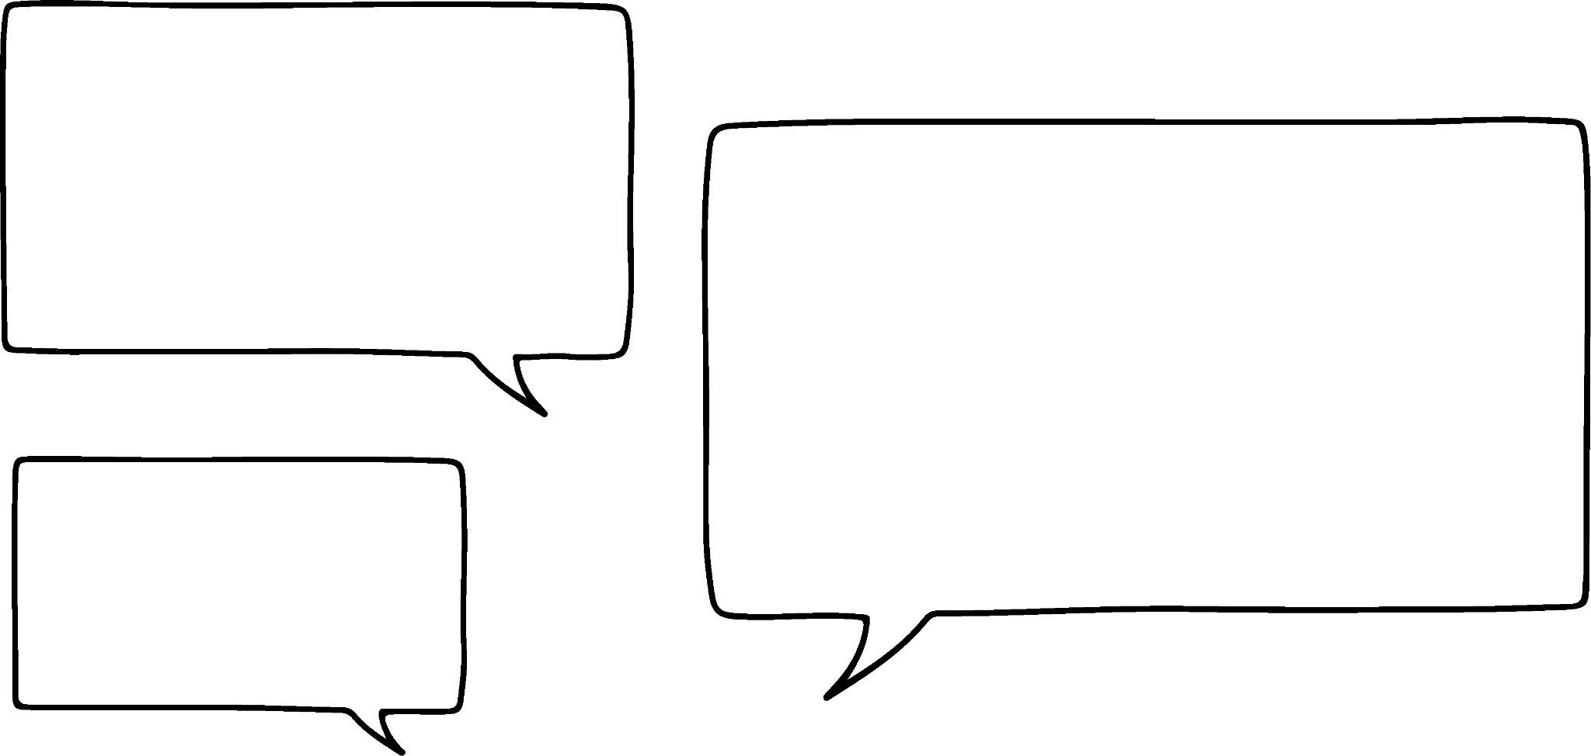
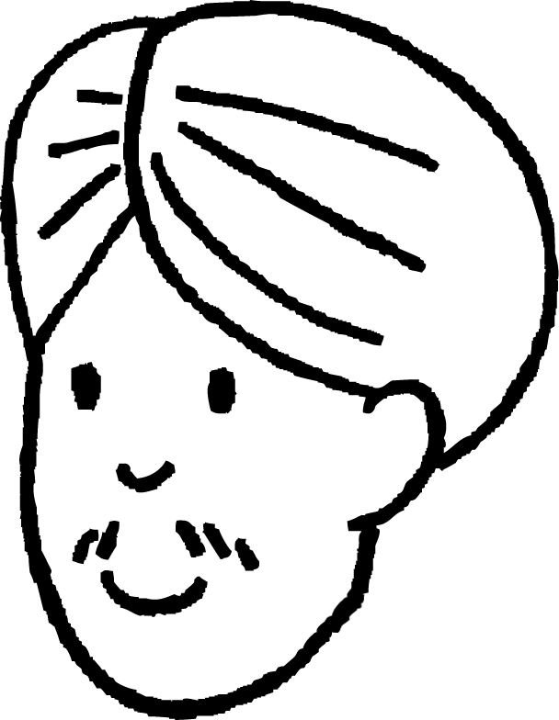
Analysing and evaluating modelled contexts
Wow, there are so many more right-angles and triangles hidden in the world than I thought!
Yeah, but do all of these situations actually have right angles in them?
Andeep
Laura
flight path of bird
9 m
tree
Like, weren’t we making a LOT of assumptions about the bird and the tree?
bird
3 m

Slide 29
Analysing and evaluating modelled contexts
When modelling we often have to make sensible assumptions to solve the problem. Some assumptions include:
assuming all lengths and distances are linear paths, and not curves
assuming two lengths or distances are perpendicular to each other, and not a different angle
assuming the two perpendicular lengths touch or intersect in some way

Slide 30
Analysing and evaluating modelled contexts
For this saucepan, it was sensible to assume the maximum base and height are perpendicular and touch at the circumference of the circle at the base of the pan.
12 cm
22 cm
For this saucepan, what assumption doesn’t hold true which means we cannot model this as a right-angled triangle?
12 cm
None of the three lengths are perpendicular to each other.
18 cm

Slide 31
Analysing and evaluating modelled contexts
1) Radio towers must be at most 3000 m apart from each other in order for the radio signal to be broadcast to the local area.
Radio tower B is 1900 m north of radio tower A.
And radio tower C is 2400 m west of radio tower A.
a) Model the distances between all three radio towers on this right-angled triangle, labelling each vertex A, B, or C to represent the three towers.
b) Radio tower A breaks down. Are radio towers B and C close enough to each other for the radio signal to still be broadcast? Explain how you know.

Slide 32

Analysing and evaluating modelled contexts
2) A lighthouse is 50 metres tall, and the light from it travels 130 metres to reach the boat.
The captain of the boat confidently declares:
“we are 120 metres away from the shore”.
Explain why the captain might be wrong.
You may reference assumptions made by the captain that are incorrect.
130 m
50 m

Slide 33
Analysing and evaluating modelled contexts
3) A window cleaner needs to reach a window that is 412 cm above ground. This is safe to do if the horizontal distance from the wall to the foot of the ladder is a quarter of the height the ladder needs to reach.
a) Model this situation on this right-angled triangle, labelling any known lengths and which side of the triangle is modelling the ladder.
b) To what length should the window cleaner set their ladder?
c) What assumptions are you making about this context?

Slide 34
Analysing and evaluating modelled contexts
4) A phone mast that is 15 m in height is supported by a 24 m long cable that is tied to the ground with a hook.
Two lights are attached: one at the top of the phone mast, and the other at the hook, to reduce the risk of people walking into it at night time.
In order for the lights to work, a battery generator is attached to the base of the phone mast, and needs to be connected to both lights by an electrical wire.
a) Is a 35 metre long reel of electrical wire enough to connect the battery to both lights?
b) What assumptions have you made about this context in part a)?

Slide 35
Analysing and evaluating modelled contexts
1) Radio towers must be at most 3000 m apart from each other in order for the radio signal to be broadcast to the local area.
Radio tower B is 1900 m north of radio tower A.
And radio tower C is 2400 m west of radio tower A.
a) Model the distances between all three radio towers on this right-angled triangle, labelling each vertex A, B, or C to represent the three towers.
b) Radio tower A breaks down. Are radio towers B and C close enough to each other for the radio signal to still be broadcast? Explain how you know.
B
3061 m
1900 m
C
A
2400 m
The radio signal will be lost, as the shortest distance from radio tower B to radio tower C is over 3000 m, at 3061 m.

Slide 36
Analysing and evaluating modelled contexts
2) A lighthouse is 50 metres tall, and the light shone from it travels 130 metres to reach the boat.
The captain of the boat confidently declares:
“we are 120 metres away from the shore”.
Explain why the captain might be wrong.
You may reference assumptions made by the captain that are incorrect.
130 m
50 m
From the right-angle triangle model of the lighthouse and boat, 120 m is correct. So why is he wrong?
120 m

Slide 37
Analysing and evaluating modelled contexts
Possible answers could include:
The shore is horizontally closer to the boat than the lighthouse is.
50 m
The height of the lighthouse isn’t the total vertical distance to sea level. So, the captain hasn’t factored in that extra vertical distance.
???
distance to lighthouse
distance to shore

Slide 38
Analysing and evaluating modelled contexts
3) A window cleaner needs to reach a window that is 412 cm above ground. This is safe to do if the horizontal distance from the wall to the foot of the ladder is a quarter of the height the ladder needs to reach.
a) Model this situation on this right-angled triangle, labelling any known lengths and which side of the triangle is modelling the ladder.
424.68 cm
distance ladder needs to reach
412 cm
height to window
103 cm

Slide 39
Analysing and evaluating modelled contexts
3) A window cleaner needs to reach a window that is 412 cm above ground. This is safe to do if the horizontal distance from the wall to the foot of the ladder is a quarter of the height the ladder needs to reach.
b) To what length should the window cleaner set their ladder?
The distance the ladder needs to reach is 424.68 cm.
Therefore, the window cleaner needs to set the ladder to 425 cm.
412 cm
height to window
103 cm

Slide 40
Analysing and evaluating modelled contexts
3) A window cleaner needs to reach a window that is 412 cm above ground. This is safe to do if the horizontal distance from the wall to the foot of the ladder is a quarter of the height the ladder needs to reach.
c) What assumptions are you making about this context?
Examples include:
The wall is perpendicular to the floor
The ground isn’t sloped
The ladder doesn’t bend when the window cleaner is on it
425 cm
ladder
412 cm
height to window
103 cm

Slide 41
Analysing and evaluating modelled contexts
a) Is a 35 metre long reel of electrical wire enough to connect the battery to both lights?
top of mast and light
A 35 metre long reel of electrical wire is long enough.
This is because you need 15 m of wire to connect to the light at the top of the mast, and 18.7 m to connect to the light at the hook.
15 m + 18.7 m = 33.7 m, which is less than 35 m.
24 m
15 m
hook and light
18.7 m
battery

Slide 42
Analysing and evaluating modelled contexts
b) What assumptions have you made about this context in part a)?
top of mast and light
Possible answers could include:
24 m
The phone mast is perfectly vertical, and so is perpendicular to the ground.
15 m
The cable that is modelled by the hypotenuse of the triangle is perfectly straight, and doesn’t bend or dip.
hook and light
18.7 m
battery
The ground is perfectly horizontal, and doesn’t change its gradient at any point between the hook and the mast.

Slide 43
Pythagoras’ theorem in context
There are many real-world contexts involving perpendicular lengths or distances that can be modelled as right-angled triangles.
Pythagoras’ theorem can then be used to calculate missing lengths to solve problems in context.
However, in these contexts, if some assumptions made aren’t true, this may invalidate whether the context can be modelled as a right-angled triangle, and therefore whether Pythagoras’ theorem can be used.
Some of these assumptions include: lengths and distances being linear paths, lengths being perpendicular to each other, and distances that intersect.

Slide 44

© Oak National Academy 2024.
Produced in partnership with Mathematics in Education and Industry.
Licensed on the Open Government Licence v3.0, except where otherwise stated. See Oak terms and conditions.

